Slide 1
Documentation Slides
MUSC + BF Navitoclax Study

Slide 2
Data Summary
Tumor Origin
Genetic Features
Type | COSMIC | CTD
Blood | 58 | 143
Lung | 87 | 127
Breast | 34 | 36
CNS | 27 | 42
Skin | 30 | 50
Other | 174 | 359
Total | 410 | 757
Type | COSMIC | CTD
Gene Expression | 16,062 | 16,062
CNV | 20,416 | 20,416
SNP (>=3 cases) | 311 | 857
Total | 36,789 | 37,335
Figure 2
Navitoclax Sensitivity
Response | COSMIC | CTD
Sensitive | 78 (19%) | 117 (15.5%)
Not Sensitive | 332 (81%) | 640 (84.5%)
Total | 410 | 757
Figure 1
Figure 3
Figure 1: Cell line count per cancer type across datasets sourced from the Sanger Institute COSMIC and Memorial Sloan-Kettering’s CTD² (CTD) portals. Note that while genetic information for cell lines for both data sources was drawn from the CCLE database, sensitivity to Navitoclax for those same cell lines was only available for some subset of patients with 757 and 410 measurements available from the CTD and COSMIC databases, respectively. Figure 2: Number of genes by data type provided where CNV = log2 copy number variation and SNP = named mutations within a single gene. Figure 3: Rate of Navitoclax sensitivity amongst all cell lines available for a given source.

Slide 3
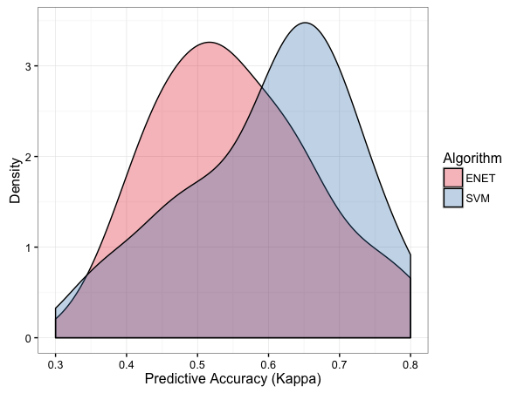
Training Process
Raw Data
Level 1 Resampling
(3x 10-fold CV)
Level 1 Resampling
(3x 10-fold CV)
…
Feature Selection + Preprocessing (Fold 1)
Feature Selection / Preprocessing (Fold 30)
Level 2 Resampling
(5-fold CV)
Level 2 Resampling
(5-fold CV)
Error Distribution Built for
Models Across Resamples
…
Parameter
Optimization (Fold 1)
Parameter
Optimization (Fold 5)
Parameter Selection + Retraining
Prediction Error Estimation
The model training and data resampling flow chart above shows how for any one learning algorithm, the out-of-sample performance of that algorithm was determined by a nested cross-validation strategy including separate resamplings for both feature selection and model parameter selection. After both of those steps were complete for any one fold, performance estimates were measured as both Kappa and Accuracy over the No-Information Rate. These performance estimates were then used to select the best learning algorithm amongst many candidates.

Slide 4
ML Models Applied
Elastic Net Regression (with and without sample weighting)
SVM (Radial Kernel)
kNN
Random Forest
GBM
Partial Least Squares
Multivariate Adaptive Regression Splines (MARS)
eXtreme Gradient Boosting
Shrinkage Discriminant Analysis (LDA with James-Stein type shrinkage) (R package)
Shrunken Centroids Regularized Discriminant Analysis (R package)
Predictive Analysis for Microarrays
Ensemble Models
Averaging Model – includes RF, SVM, Elastic Net,
GLM Model – Stacked ensemble of same as above, with GLM as stacking learner

Slide 5
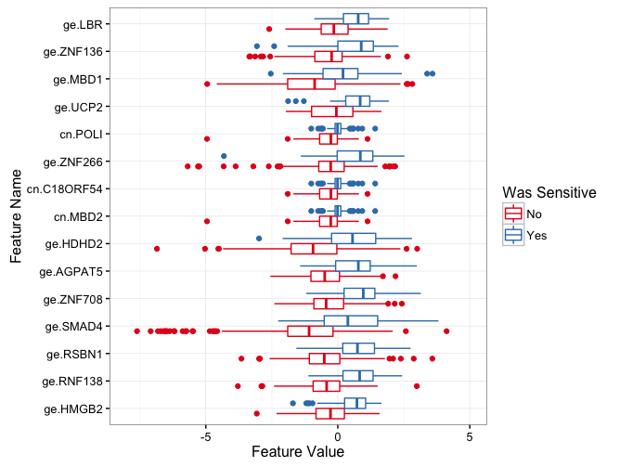
Top Features
Frequency of Feature
Selections (in resampling)
Feature Values by Navitoclax Sensitivity
Feature | Frequency
ge.HMGB2 | 30
ge.RNF138 | 30
ge.RSBN1 | 30
ge.SMAD4 | 30
ge.ZNF708 | 30
ge.AGPAT5 | 28
ge.HDHD2 | 28
cn.MBD2 | 27
cn.C18ORF54 | 26
ge.ZNF266 | 26
cn.POLI | 25
ge.UCP2 | 22
ge.MBD1 | 21
ge.ZNF136 | 21
ge.LBR | 18
cn.WDR7 | 14
ge.ABHD18 | 13
ge.CXXC1 | 12
ge.ZNF292 | 12
ge.ME2 | 11
ge.CXCR4 | 10
Figure 1
Figure 2
Figure 1: Rate of selection of individual features across 30 primary folds where feature name has the format [data type].[gene name] (ge = gene expression, cv = copy number variation). For numeric features, a two-sided t-test was used to determine feature rank under the constraint that the sign of the difference in mean sensitivity across sensitive and insensitive patients is the same for a single gene’s copy number variation and gene expression values (i.e. they must both exhibit over-expression OR under-expression to be considered). Figure 2: Distributions of a few copy number and gene expression values grouped by cell line Navitoclax sensitivity.

Slide 6
Kappa vs #Features (COSMIC)
Figure 1
Figure 1: Mean kappa estimates (across 30 folds) for each learning algorithm applied as a function of the number of genetic features used in training. Note that the separation in performance between those algorithms is relatively slight and that performance reaches a local maxima at around 20-30 features.

Slide 7
Accuracy vs #Features (COSMIC)
Figure 1
Figure 1: Mean accuracy over no-information rate estimates (across 30 folds) for each learning algorithm applied as a function of the number of genetic features used in training. Note that the separation in performance between those algorithms is relatively slight and that performance reaches a local maxima at around 20-30 features.

Slide 8
Kappa vs #Features (CTD)
Figure 1
Figure 1: Mean kappa estimates (across 30 folds) for each learning algorithm applied as a function of the number of genetic features used in training. Note that Kappa estimates for models trained on CTD data are less than half that of the same models trained on the COSMIC data.

Slide 9
Accuracy vs #Features (CTD)
Figure 1
Figure 1: Mean accuracy over no-information rate estimates (across 30 folds) for each learning algorithm applied as a function of the number of genetic features used in training. Note that performance for models trained on CTD data (shown above) are less than one third that of the same models trained on the COSMIC data.

Slide 10
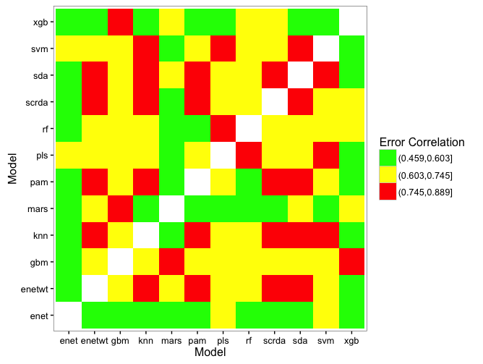
Ensemble Selection
Kappa Correlation Between Models
(across 30 folds)
SVM, SCRDA, and RF chosen due to relatively high performance and mid-range correlation in those same measurements
Figure 1
Figure 1: Correlation matrix approximating similarity between performance estimates across learning algorithm types. Base learning models used for ensemble model generation were selected based on trying to maximize their dissimilarity in performance while favoring models that still perform well over all, relative to all others.

Slide 11
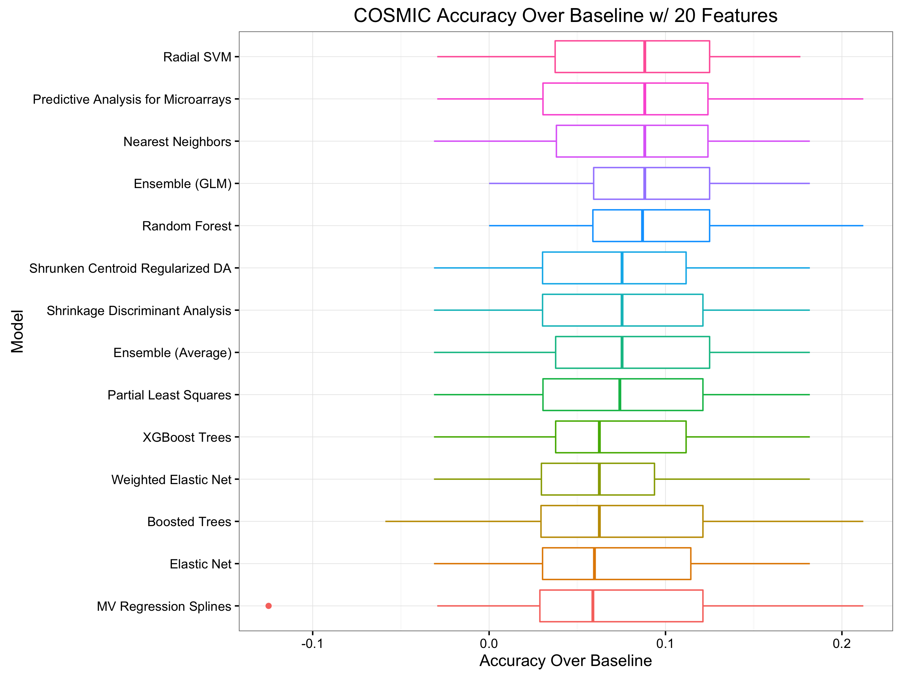
Model Accuracy (COSMIC)
Figure 1
Figure 1: Accuracy over no-information rate performance distributions (across 30 folds) for each learning algorithm trained on exactly 20 input genetic features.

Slide 12
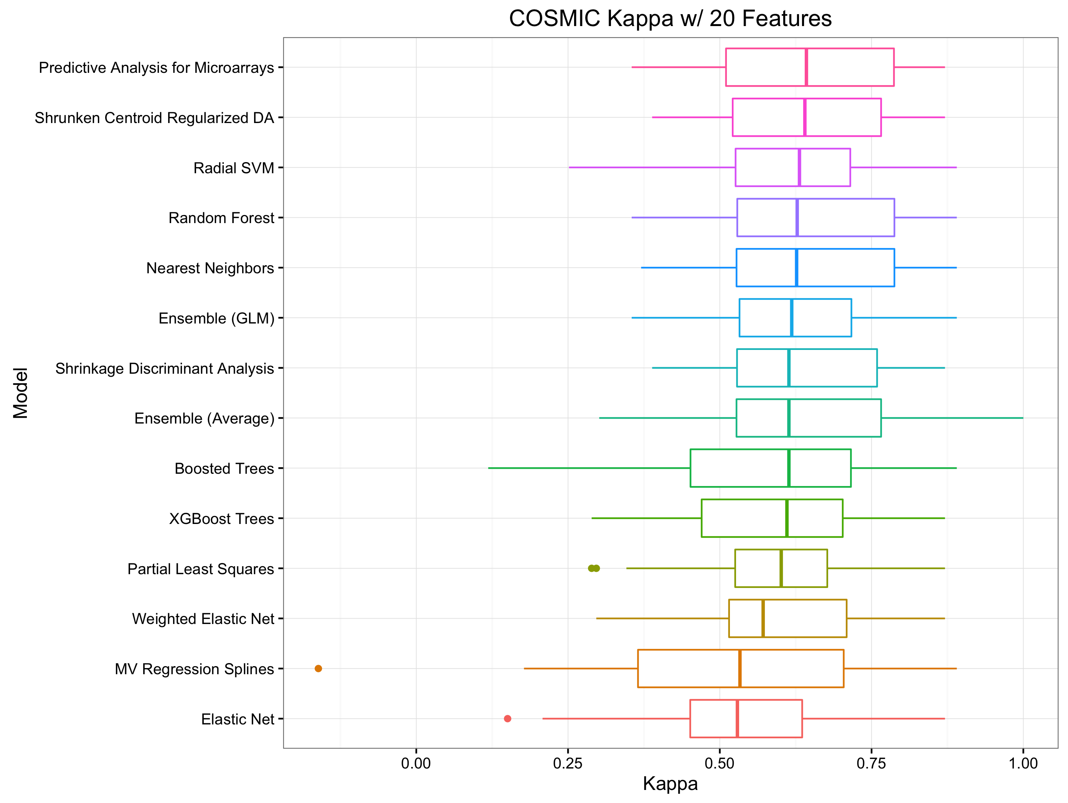
Model Kappa (COSMIC)
Figure 1
Figure 1: Kappa performance distributions (across 30 folds) for each learning algorithm trained on exactly 20 input genetic features.

Slide 13
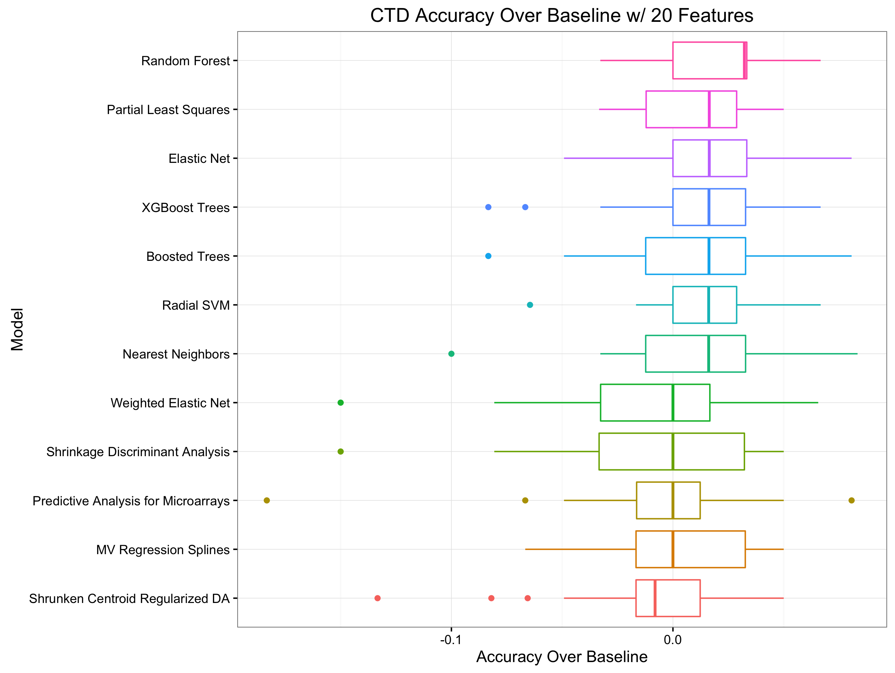
Model Accuracy (CTD)
Figure 1
Figure 1: Accuracy over no-information rate performance distributions (across 30 folds) for each learning algorithm trained on exactly 20 input genetic features.

Slide 14
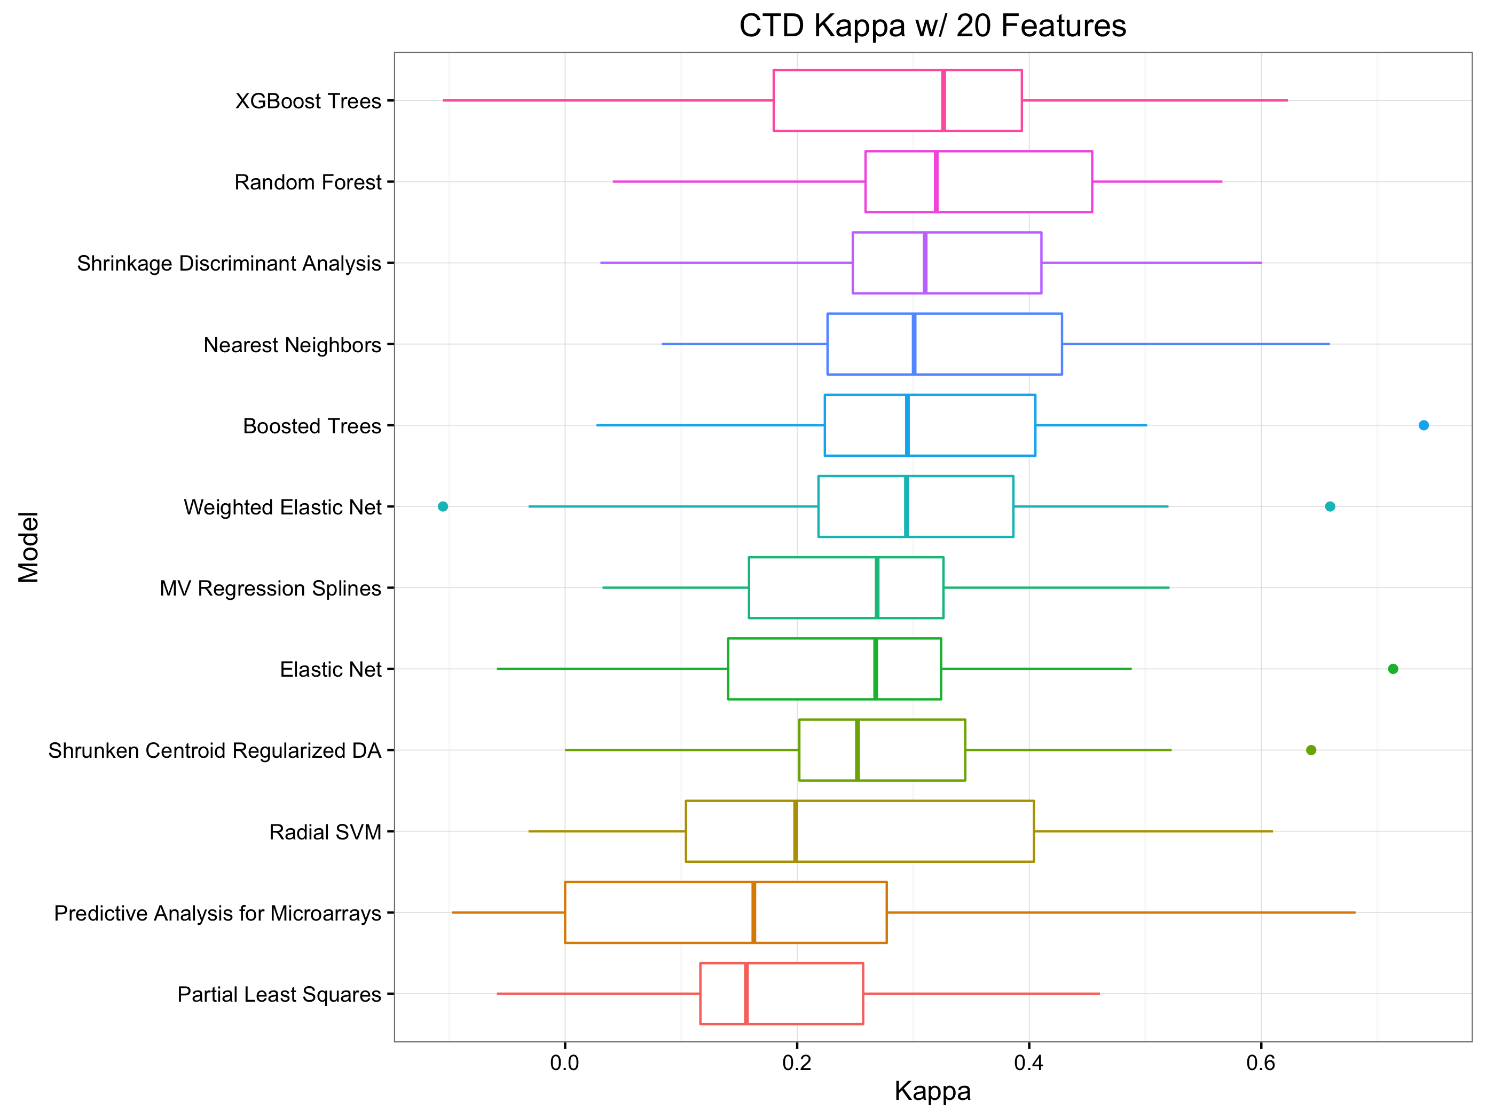
Model Kappa (CTD)
Figure 1
Figure 1: Kappa performance distributions (across 30 folds) for each learning algorithm trained on exactly 20 input genetic features.

Slide 15
Accuracy In Practice (Precursor)
All results so far have been shown with respect to a “training” dataset chosen as 80% (randomly) of the original dataset for either source (COSMIC or CTD)
To estimate how well the above approaches would extend to a laboratory setting, the following was done:
The glm ensemble model over SCRDA, SVM, and RF predictions was retrained on the entire training dataset (80% of the original)
This ensemble was used to make predictions for the remaining 20% of the data as probabilities of any one sample being sensitive to the Navitoclax treatment
The accuracy of these predictions was summarized as gain and sensitivity charts in the following slides

Slide 16
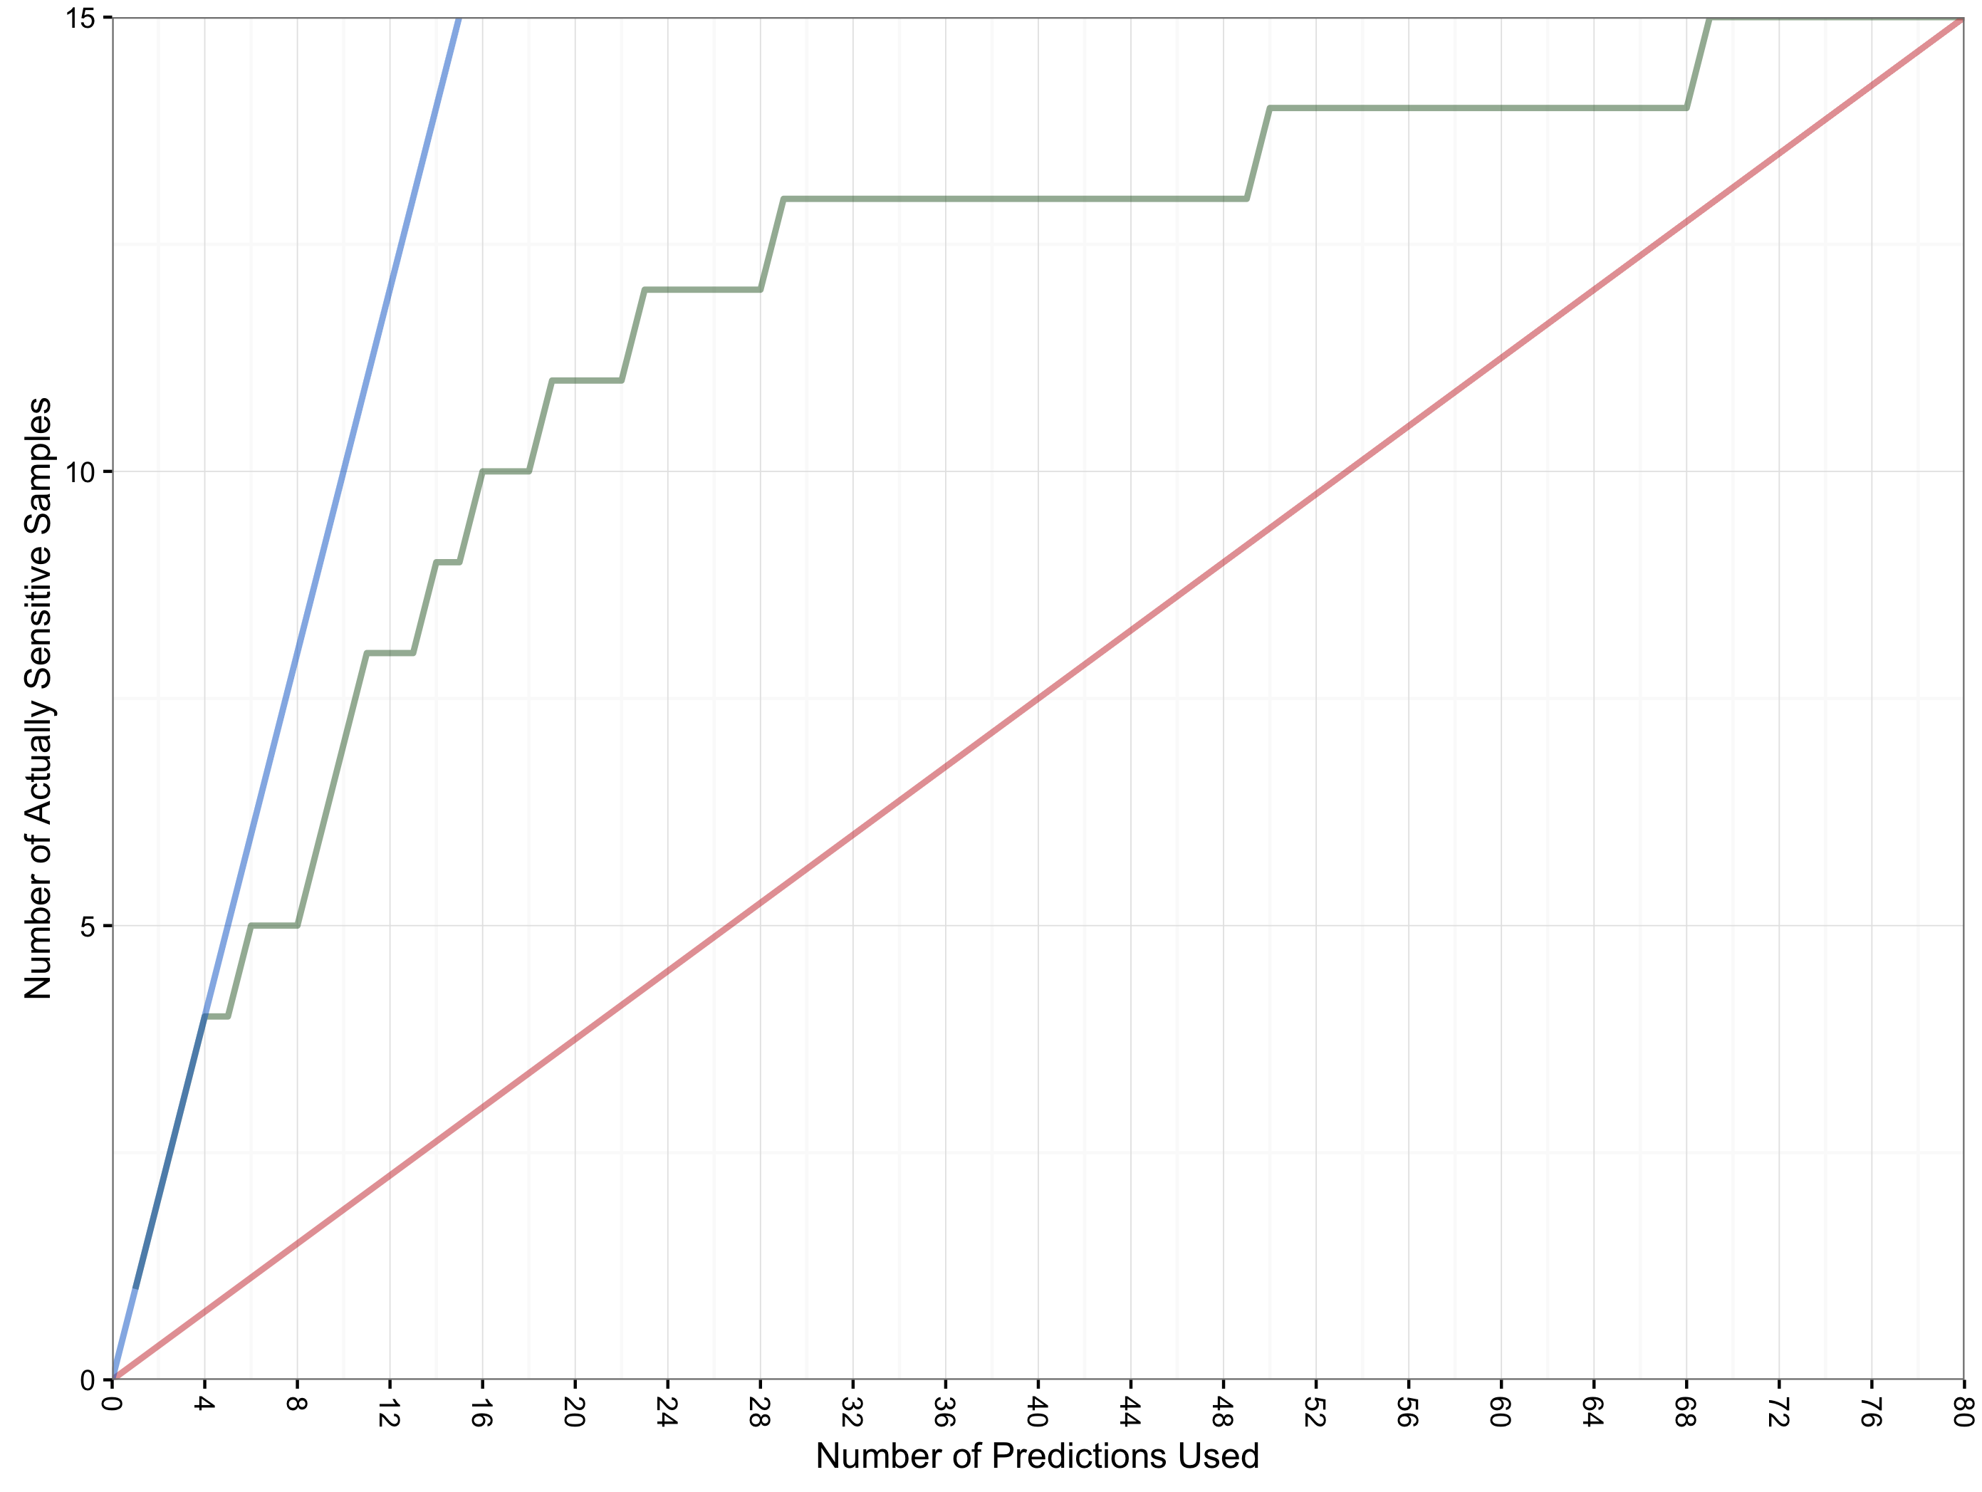
Gain In Practice (COSMIC)
GLM Ensemble Gain Chart for COSMIC Holdout
Perfect Model
Ensemble
Model
8 of the top 11 samples predicted as most likely to be sensitive were truly sensitive
Random Model
Predictions of highest probability are used first
Figure 1
Figure 1: Gain chart for predictions made on hold-out dataset from COSMIC database. Note that the original dataset from this source consisted of 410 samples and that 330 of those samples were used for training while 80 were set aside for the purpose of estimating model performance in practice (shown above). In that 80 sample hold-out set, 15 samples were truly sensitive to Navitoclax treatment and the chart shows how the number of those samples increases as a function of the number of predictions considered from the model.

Slide 17
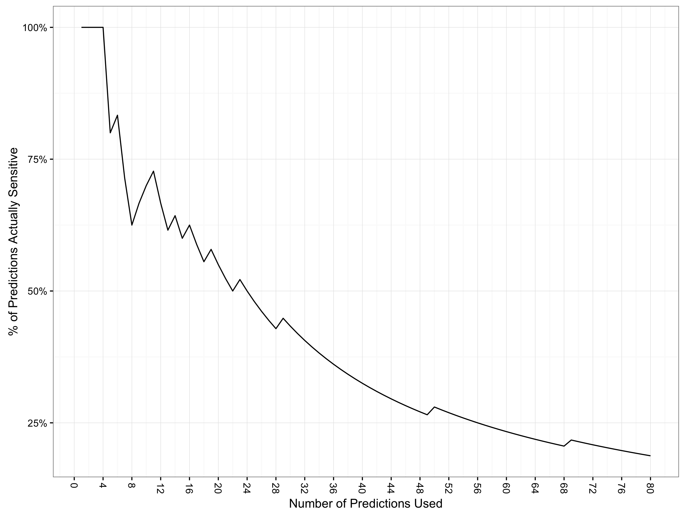
Accuracy In Practice (COSMIC)
GLM Ensemble Sensitivity vs Prediction Count
At 22 predictions of 80 considered (27.5% of samples), accuracy falls to 50%
Predictions of highest probability are used first
Figure 1
Figure 1: Sensitivity vs Rate-of-Positive-Predictions for predictions made on hold-out dataset from COSMIC database. Note that the original dataset from this source consisted of 410 samples and that 330 of those samples were used for training while 80 were set aside for the purpose of estimating model performance in practice (shown above). In that 80 sample hold-out set, 15 samples were truly sensitive to Navitoclax treatment and the chart shows how the percentage of those samples increases as a function of the number of predictions considered from the model.

Slide 18
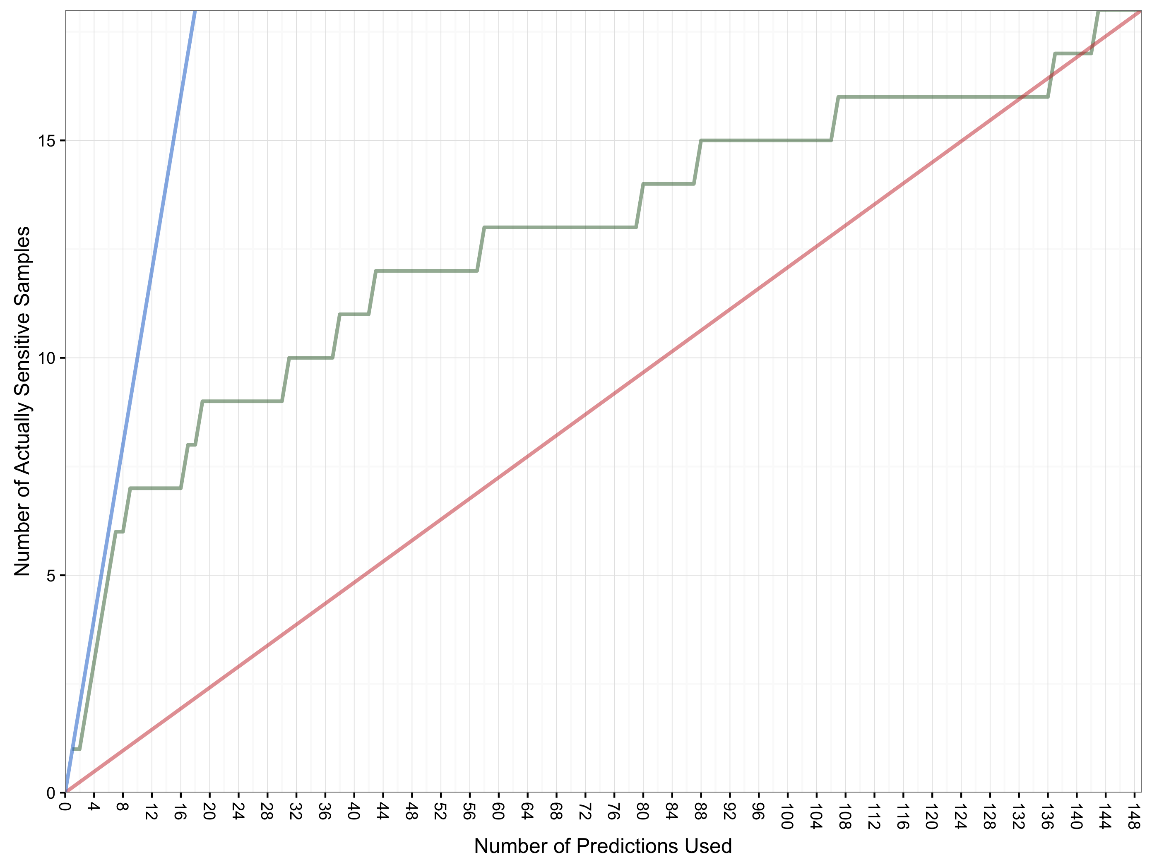
Gain In Practice (CTD)
GLM Ensemble Gain Chart for CTD Holdout
Ensemble
Model
Perfect Model
7 of the top 9 predictions are correct but after that performance degrades to that of a random model (or worse)
Random Model
Predictions of highest probability are used first
Figure 1
Figure 1: Gain chart for predictions made on hold-out dataset from CTD database. Note that the original dataset from this source consisted of 757 samples and that 608 of those samples were used for training while 149 were set aside for the purpose of estimating model performance in practice (shown above). In that 149 sample hold-out set, 18 samples were truly sensitive to Navitoclax treatment and the chart shows how the number of those samples increases as a function of the number of predictions considered from the model.

Slide 19
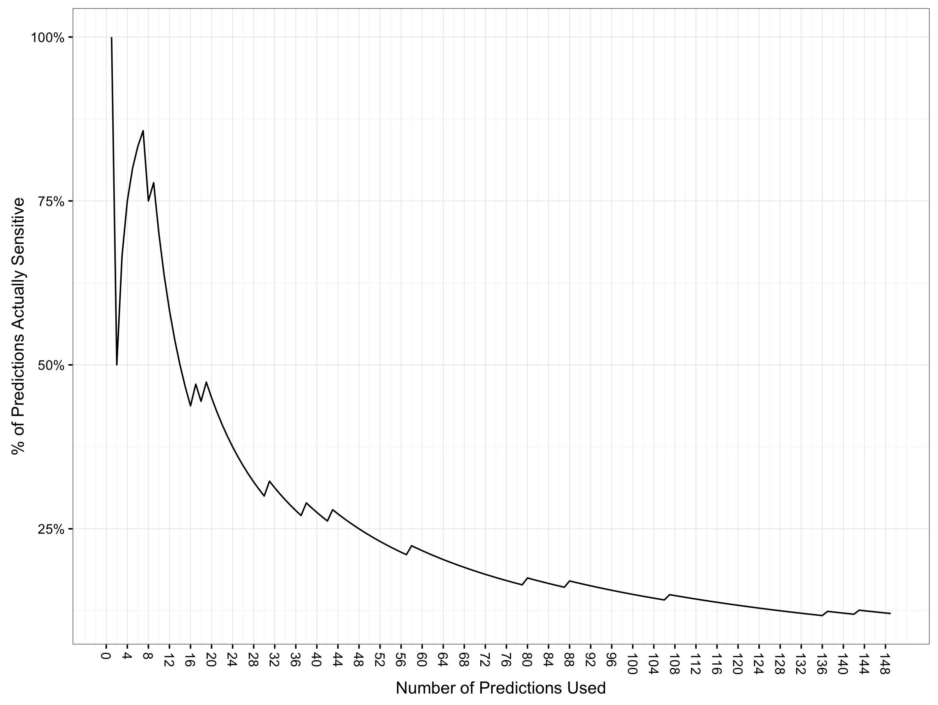
Accuracy In Practice (CTD)
GLM Ensemble Sensitivity vs Prediction Count
At 14 predictions of 149 considered (9.3% of samples), accuracy falls to 50%
Predictions of highest probability are used first
Figure 1
Figure 1: Sensitivity vs Rate-of-Positive-Predictions for predictions made on hold-out dataset from CTD database. Note that the original dataset from this source consisted of 757 samples and that 608 of those samples were used for training while 149 were set aside for the purpose of estimating model performance in practice (shown above). In that 149 sample hold-out set, 18 samples were truly sensitive to Navitoclax treatment and the chart shows how the percentage of those samples increases as a function of the number of predictions considered from the model.

